Slide 1

E-commerce Product Classification using Machine Learning
Flipkart Mobiles
Sanjaikumar S DA & DS Feb 2025
22-07-2025

Slide 2
Project Objective :
To analyze product data from an e-commerce platform (Flipkart).
To classify products based on price range using supervised machine learning.
To identify the best performing model using evaluation metrics like F1 Score.
To document the entire workflow from web scraping to model saving and reporting.

Slide 3
Data Collection :
Scraped product details from Flipkart using BeautifulSoup.
Features scraped:
Product Name
Price
Rating
Number of Reviews

Slide 4
Data Cleaning:
Remove Nulls
Remove Duplicates
Change Datatypes for columns
Standardize Names
Data saved in CSV file and later loaded into MySQL for analysis.

Slide 5
Data Preprocessing :
Handled missing values and cleaned text fields.
Converted price, ratings, and reviews to numeric format.
Created a target variable (Price Label) using KMeans clustering:
Low Price
Mid Price
High Price

Slide 6
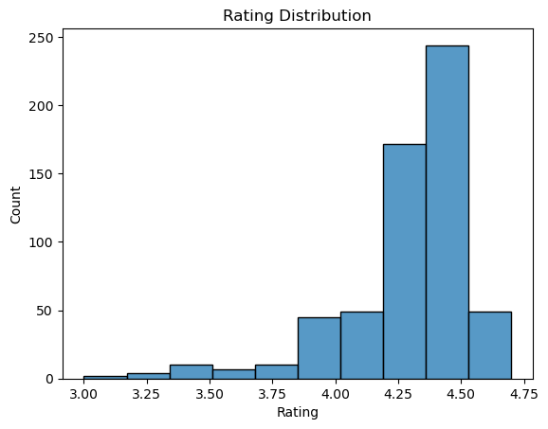
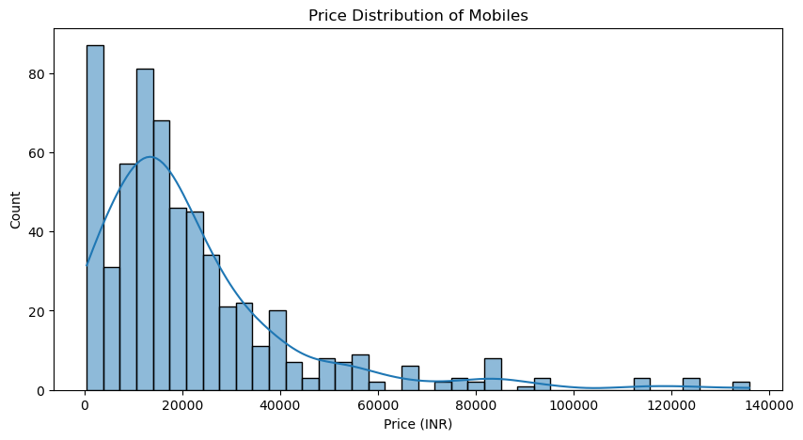
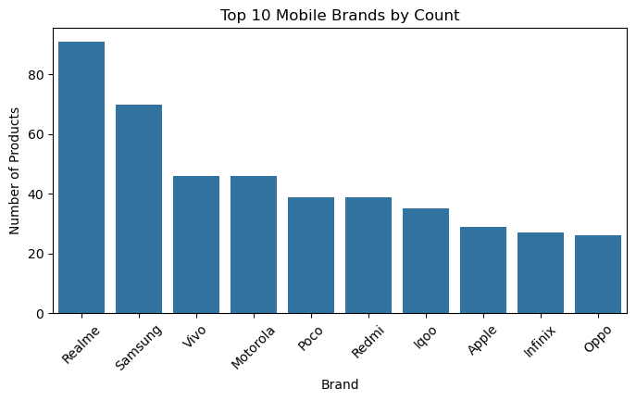
Exploratory Data Analysis (EDA)
Price Distribution: Right-skewed, majority under ₹20,000
Ratings: Majority products rated above 4
Realme, Samsung, and Vivo are the top 3 brands with the highest product count.

Slide 7
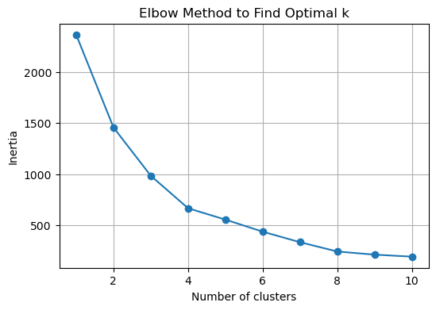
Clustering Analysis: Product Label Creation
Objective: Group similar products based on features to assign meaningful cluster labels (used for classification).
Process:
Applied KMeans Clustering to the preprocessed numerical data (e.g., price, rating, reviews).
Optimal number of clusters selected using Elbow Method.
Created new label:
Cluster 0 → Mid Range products
Cluster 1 → Upper Mid-range products
Cluster 2 → Budget products
Cluster 3 → Premium Products

Slide 8
Models Used :
Trained multiple classifiers:
Logistic Regression
Support Vector Machine (SVM)
k-Nearest Neighbors (k-NN)
Random Forest
XGBoost
Used 5-fold Cross-Validation to measure F1 Macro Score.

Slide 9
Hyperparameter Tuning
Performed GridSearchCV for best model (Random Forest):
n_estimators: [100, 200, 300]
max_depth: [5, 10, 15]
min_samples_split: [2, 5]
Tuned model achieved perfect F1 Score on test data.

Slide 10
Model Performance Comparison
Model | Train Accuracy | Train F1 | Test Accuracy | Test F1
Logistic Regression | 0.9929 | 0.9929 | 0.9916 | 0.9789
SVM | 0.9929 | 0.9929 | 0.9916 | 0.9895
k-NN | 0.9976 | 0.9976 | 0.9916 | 0.9895
Random Forest | 1.0000 | 1.0000 | 1.0000 | 1.0000
XGBoost | 1.0000 | 1.0000 | 1.0000 | 1.0000

Slide 11
Key Insights :
Most Mobiles Have High Ratings
Majority of products have ratings between 4.0 and 4.5, indicating strong customer satisfaction.
Mobile Prices Are Right-Skewed
Most products are priced below ₹20,000, but a few high-end models go up to ₹1.3 lakhs, causing a skew.
Realme, Samsung, and Vivo Dominate the Market
These brands account for the highest number of listings, suggesting popularity and wide offerings.
Ratings and Reviews Are Weakly Correlated
Scatter plot analysis shows no strong linear relationship between number of reviews and ratings.
Random Forest Performed Best After Tuning
Among all classification models, the tuned Random Forest model gave the highest F1 Macro Score, indicating better performance in handling imbalanced class predictions.

Slide 12
Conclusion:
Successfully scraped and analyzed mobile product data from Flipkart.
Performed extensive EDA to understand price, rating, and brand distribution.
Built multiple classification models; Random Forest and XGBoost showed perfect F1 scores on test data.
Derived business insights that can guide inventory, marketing, and pricing strategies.
Future Work:
Extend scraping to other platforms like Amazon or Reliance Digital for broader insights.
Include text review analysis (sentiment analysis) for deeper customer opinion mining.
Add features like screen size, battery life, camera specs, etc., for richer modeling.
Deploy model into a web-based tool to assist customers in product recommendation.

Slide 13
Thank You

